Slide 1
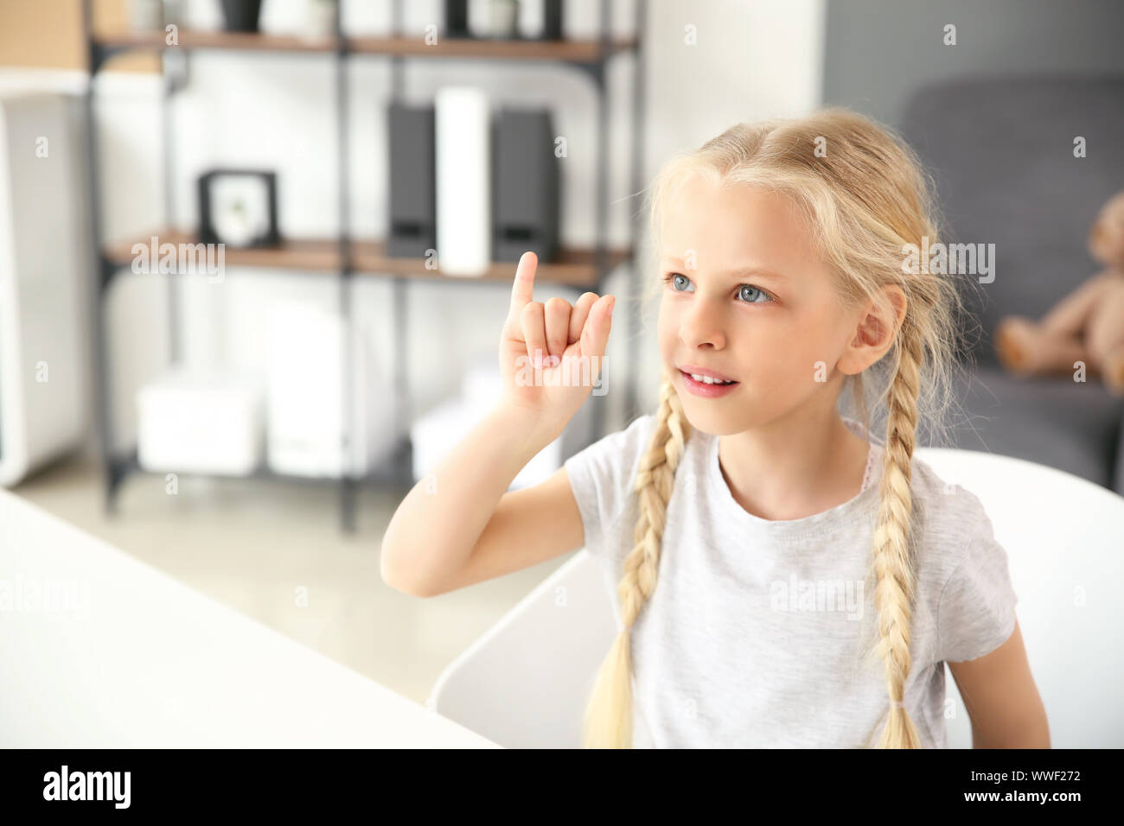
SIGN LANGUAGE RECOGNITION SYSTEM

Slide 2
GROUP MEMBERS
BSEF19M035 USAMA JAVED
BSEF19M045 SAMI AHMAD
BSEF19M018 BASSAM MALIK
BSEF19M052 HANNAN SHAMI

Slide 3
PROBLEM STATEMENT
This project is developed to understand the sign language of the
people who are unable to speak and convert the meaning of those signs
in text form and show them to the individual who wants to communicate with
the voiceless person.

Slide 4
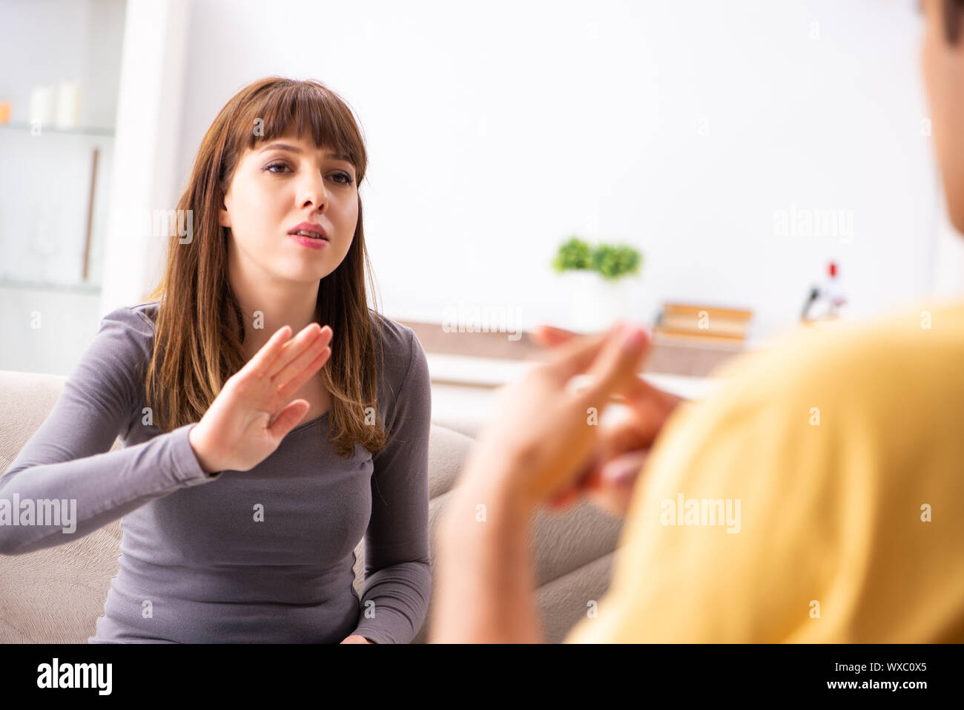
HOW TO UNDERSTAND THEM?

Slide 5
APPLICATIONS
Why is our problem worth solving?
There is a huge communication gap between the deaf and normal people. Deaf people can’t communicate with normal one’s because normal people can’t understand their sign gestures. So to fill this gap we need a system which can convert those sign gestures to text.

Slide 6
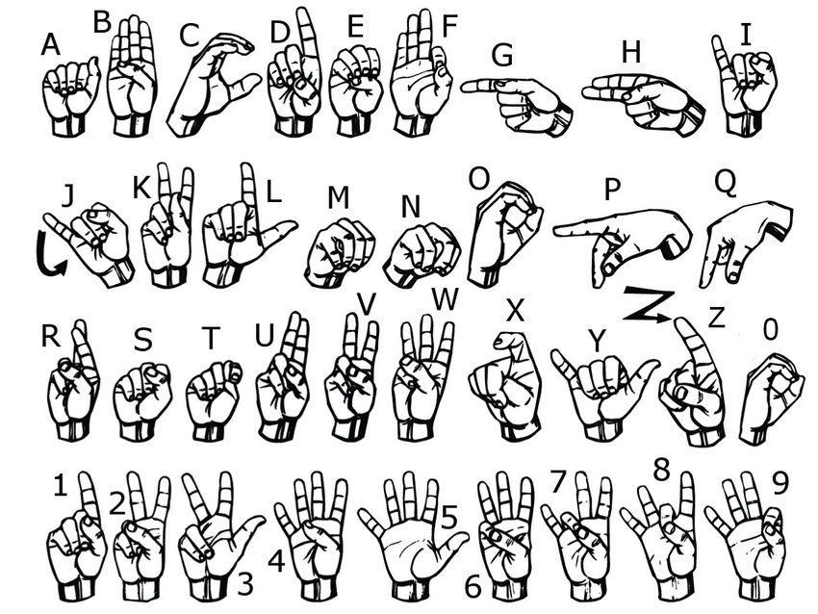
AMERICAN SIGN LANGUAGE

Slide 7
PROPOSED SOLUTION
Used Approximately 500 images for every character from A to Z for model training.
Used CvZone library for hand detection in live webcam.
Sent those images frame by frame to model for prediction.
Displayed the prediction on the same screen using cvZone.

Slide 8
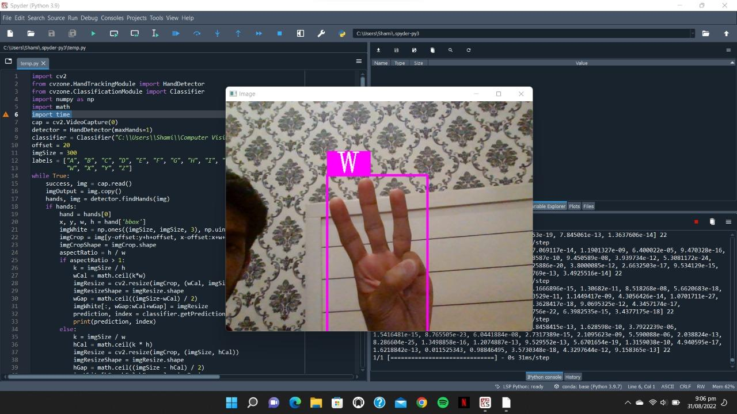
RESULTS
ACCURACY: 60-70%

Slide 9
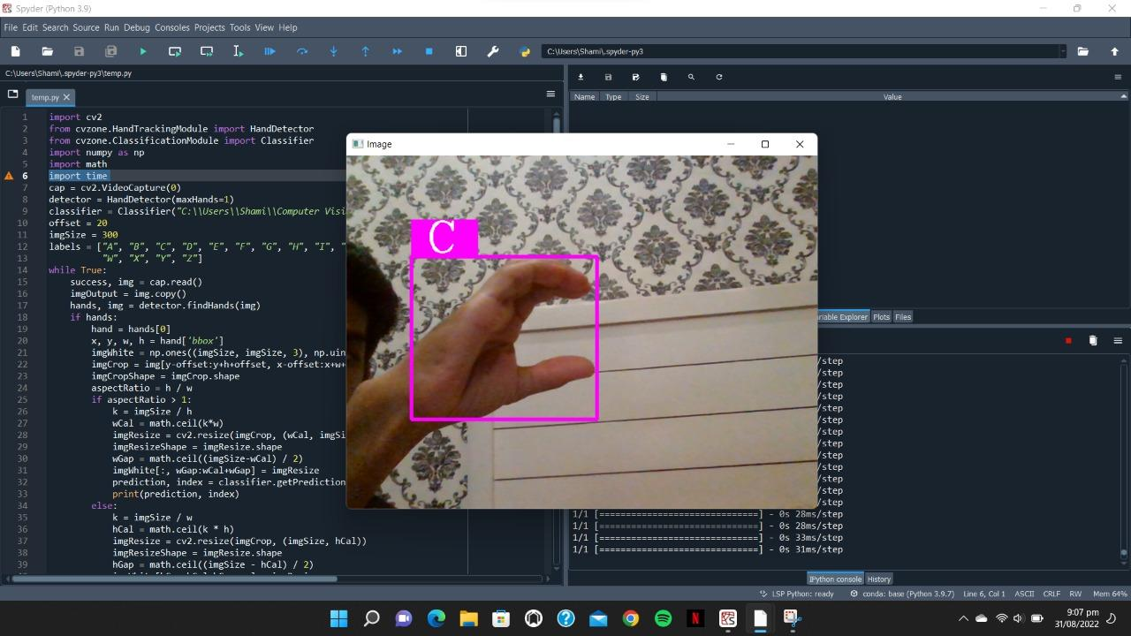

Slide 10
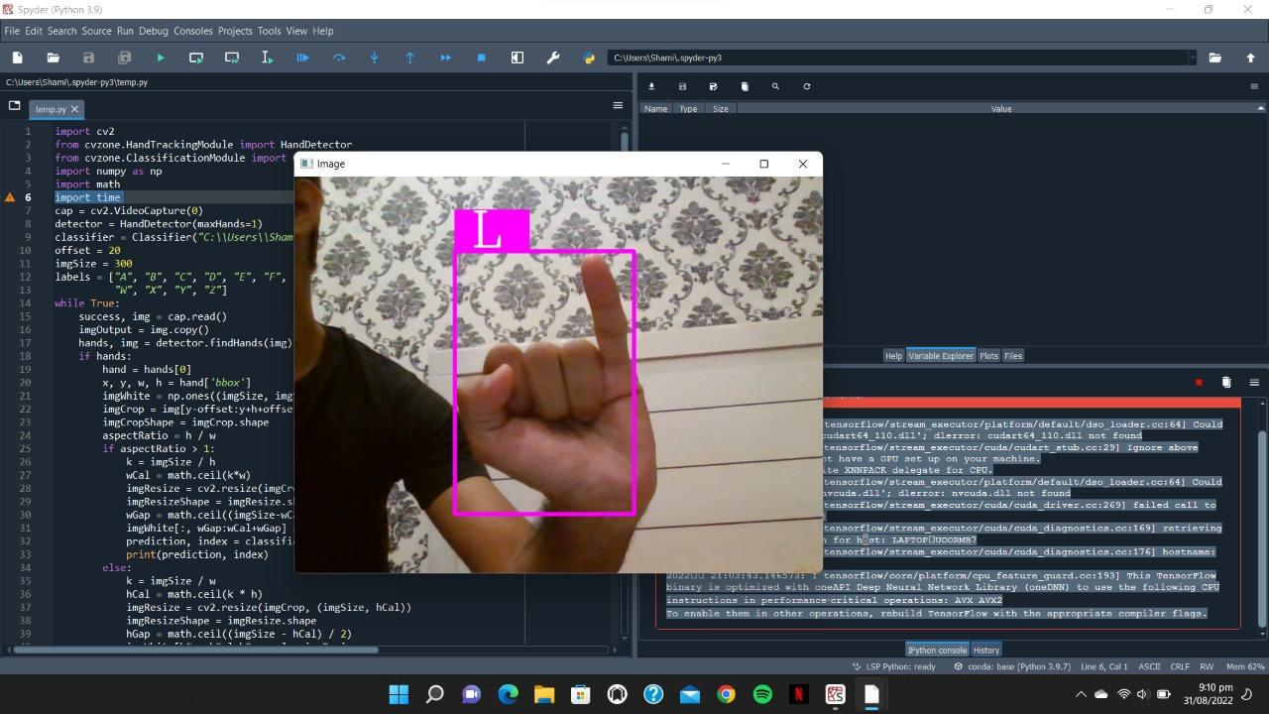

Slide 11
FUTURE DIRECTIONS
In future we can develop an app using this system which will help deaf people to type mail and messages through gestures.
In future we can develop a voice assistant in this system for the deaf and dumb people to communicate with normal ones fluently.
And vice versa we can create a voice translator which will translate the voice of normal person to sign language for the understanding of deaf and dumb people

Slide 12
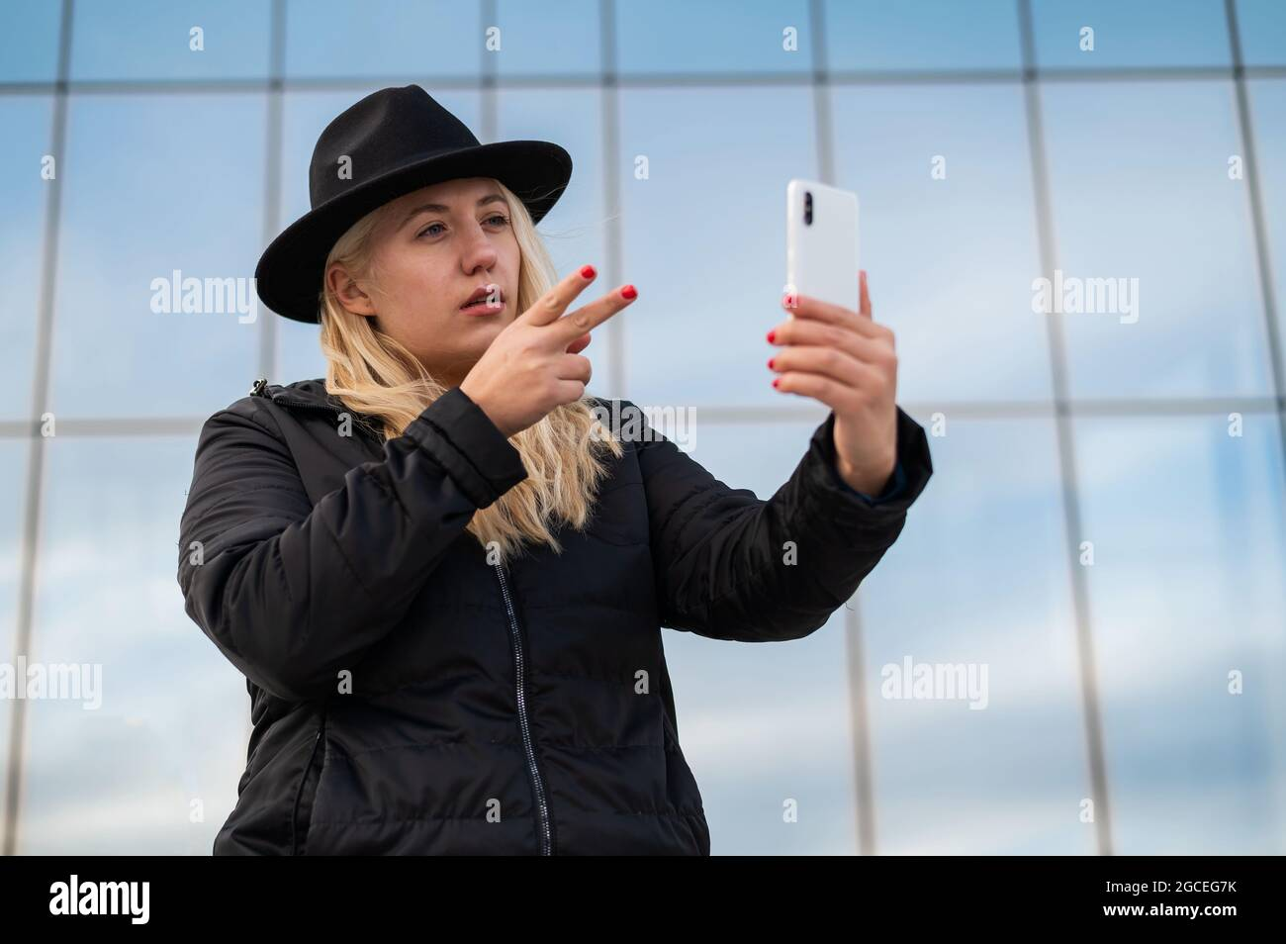

Slide 13
CONTRIBUTION
“The strength of the team is each individual member.
The strength of each member is the team”

Slide 14
REFERENCES
https://github.com/cvzone/cvzone
https://teachablemachine.withgoogle.com/train

Slide 15
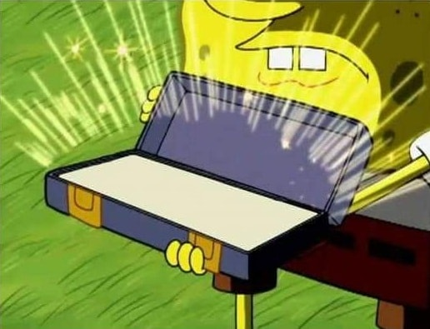
ANY QUESTIONS?

